Slide 1
Introduction to
IT Project Management
Dr. Inas Ezz
Spring Semester 2020
Page 1
IT Project Management-Tutorial 5

Slide 2
STRATEGIC PLANNING AND PROJECT SELECTION
IT Project Management-Tutorial 5

Slide 3

There are usually more projects than available time and resources to implement them
Methods for selecting projects include:
  focusing on broad organizational needs
  categorizing information technology projects
  performing net present value or other financial analyses
  using a weighted scoring model
  implementing a balanced scorecard
Information Technology Project Management, Seventh Edition

Slide 4
Financial considerations are often an important consideration in selecting projects
Three primary methods for determining the projected financial value of projects:
  Net present value (NPV) analysis
  Return on investment (ROI)
  Payback analysis
Information Technology Project Management, Seventh Edition

Slide 5

Return on investment (ROI) is calculated by subtracting the project costs from the benefits and then dividing by the costs
  ROI = (total discounted benefits - total discounted costs) / discounted costs
The higher the ROI, the better
Many organizations have a required rate of return or minimum acceptable rate of return on investment for projects

Slide 6

The payback period is the amount of time required for cash inflows generated by a project to offset its initial cash outflow.
Payback occurs when the net cumulative discounted benefits equals the costs.
Many organizations want IT projects to have a fairly short payback period

Slide 7
Net present value (NPV) analysis is a method of calculating the expected net monetary gain or loss from a project by discounting all expected future cash inflows and outflows to the present point in time
Projects with a positive NPV should be considered if financial value is a key criterion
The higher the NPV, the better

Slide 8

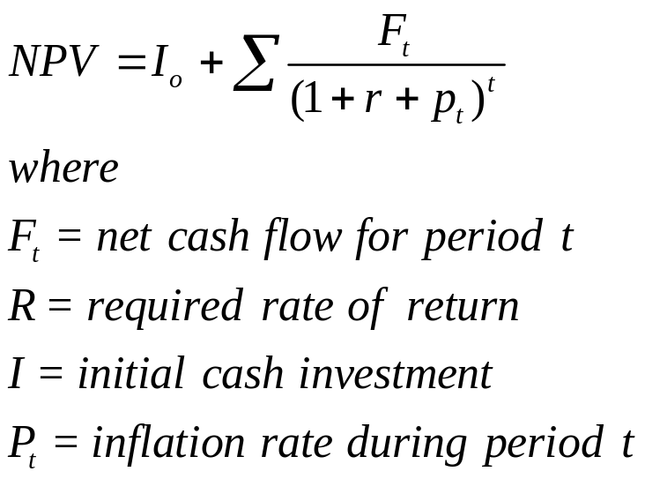
Projects the change in the firm’s stock value if a project is undertaken.
Higher NPV values are better!

Slide 9

Assignment 1
IT application for Tokyo 2020 Olympics

